Slide 1

TED TALKS VIEWS PREDICTION
BY: 221FA14037
3 BI -A

Slide 2
INTRODUCTION
Predicting the number of views a TED Talk will receive is a challenging but intriguing problem. Factors like the speaker's popularity, the topic's relevance, and the quality of the presentation can all influence viewership. Linear regression, a statistical method that models the relationship between a dependent variable and one or more independent variables, can be a valuable tool in this prediction task.
Linear Regression: A Definition
Linear regression is a statistical method used to model the relationship between a dependent variable and one or more independent variables. It assumes a linear relationship between the variables and aims to find the best-fitting straight line that represents this relationship. This line is typically represented by the equation y = mx + b, where y is the dependent variable, x is the independent variable, m is the slope of the line, and b is the y-intercept. .

Slide 3
Types of Linear Regression
Simple Linear Regression: This involves a single independent variable.
Multiple Linear Regression: This involves multiple independent variables.
Polynomial Regression: This uses a polynomial equation to model the relationship, allowing for more complex curves.
Logistic Regression: While not strictly linear, it's used to predict categorical outcomes (e.g., yes/no) based on numerical predictors
Applications
Linear regression is widely used in various fields, including:
Economics: Predicting stock prices, consumer spending, and economic growth.
Statistics: Analyzing relationships between variables.
Machine Learning: Building predictive models.
Engineering: Modeling physical systems.
Social Sciences: Studying relationships between social phenomena.
By understanding the concepts and applications of linear regression, you can effectively analyze data and make informed predictions.

Slide 4
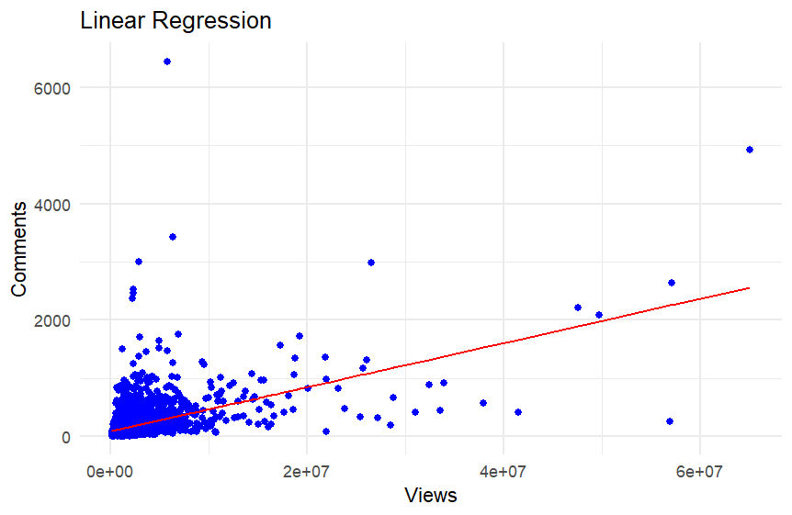
Output Of Ted Talks using R script in R Studio Views vs comments:
The graph shows a linear regression analysis between the number of views(Y-axis) and the number of comments(X-axis) on a set of data points
.Data Points: Scattered blue dots represent individual data Points, each representing a specific video's view count and comment count.
Regression Line: The red line is the regression line, which represents the best-fit linear relationship between the number of views and the number of comments.

Slide 5
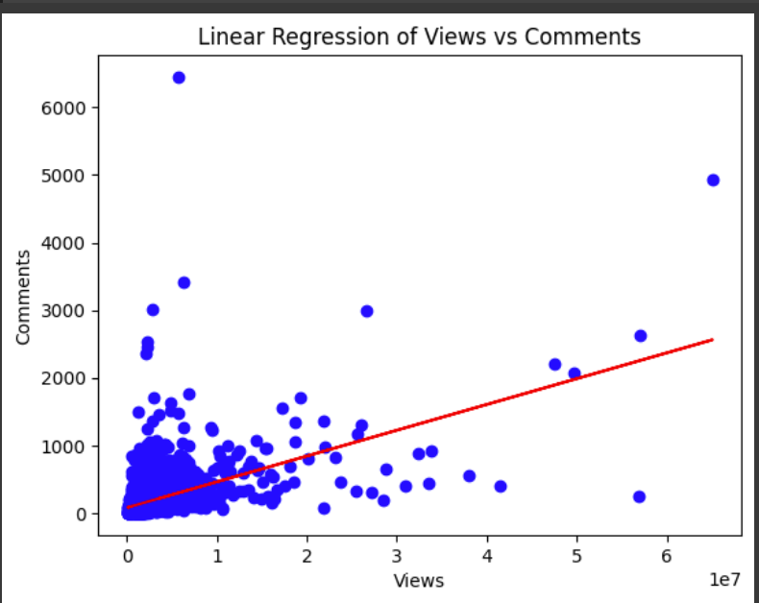
Output Of Ted Talks In Python using Google collab:
X-axis: Views (Number of views)
Y-axis: Comments (Number of comments)
Data Points: Scattered blue dots represent individual data points, each representing a specific video's view count and comment count.
Regression Line: The red line is the regression line, which represents the best-fit linear relationship between the number of views and the number of comments.

Slide 6
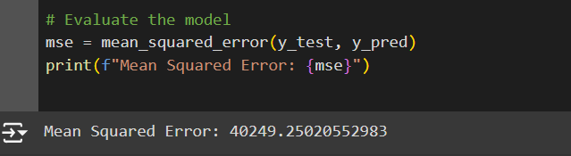
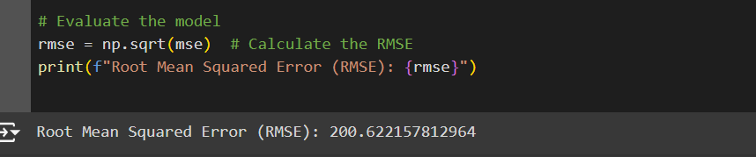
Mean square error(MSE):
Root Mean Squared Error (RMSE):

Slide 7
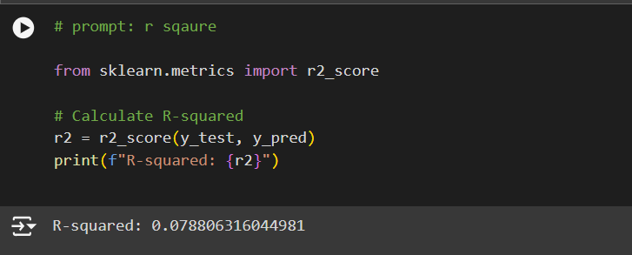
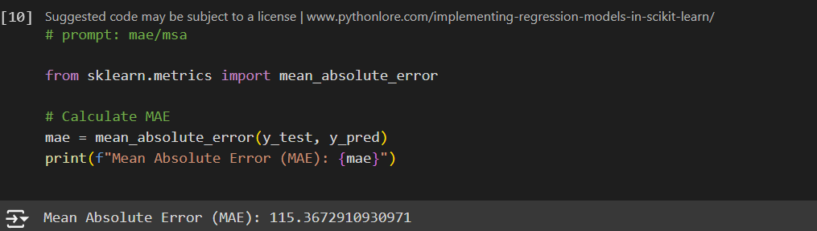
R-squared:
Mean Absolute Error:

Slide 8
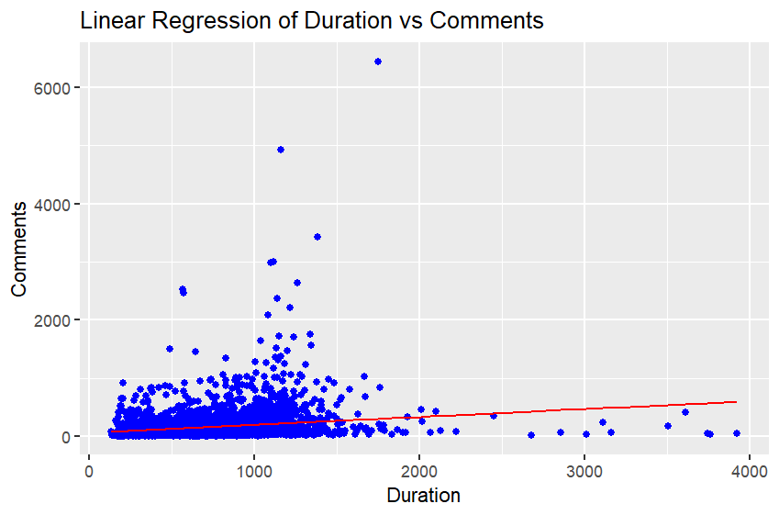
Other example: Output Of Ted Talks using R script in R Studio Duration vs comments:
X-axis: Views (Number of views)
Y-axis: Comments (Number of comments)
Data Points: Scattered blue dots represent individual data points, each representing a specific video's view count and comment count.
Regression Line: The red line is the regression line, which represents the best-fit linear relationship between the number of views and the number of comments.

Slide 9
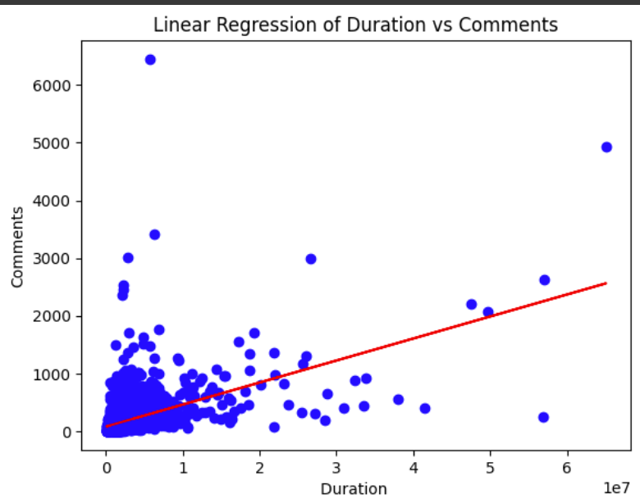
Output Of Ted Talks In Python using Google collab Duration vs Comments :
X-axis: Duration (Duration of the video)
Y-axis: Comments (Number of comments)
Data Points: Scattered blue dots represent individual data points, each representing a specific video's duration and comment count.
Regression Line: The red line is the regression line, which represents the best-fit linear relationship between the duration of a video and the number of comments.

Slide 10
Conclusion
Linear regression offers a solid foundation for predicting TED Talk views, considering factors like speaker popularity, topic relevance, and video length. While it may not capture all nuances, it provides valuable insights and can serve as a baseline for more complex models. By addressing challenges like non-linearity and outliers, and exploring advanced techniques, we can further enhance the accuracy and reliability of TED Talk view predictions.

Slide 11
THANK YOU

